Slide 1
Enterprise Information
Knowledge is Power

Slide 2
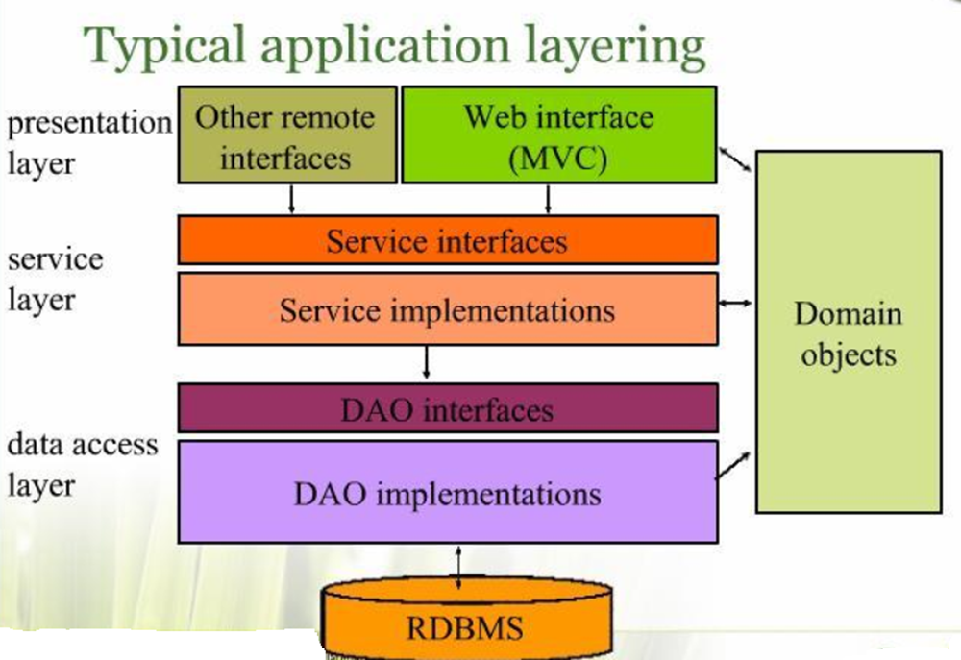
The Domain Model is Essential

Slide 3
Domain Model
Application Design is Driven by the Business Domain [Model].
The domain model is the central, organizing component of the Enterprise
ALL application functionality is derived from it.
The rest of the Enterprise is involved in modifying, validating, moving, translating and presenting …the Domain Model - DATA
Notes:
Domain Model is fndamental to EVERYTHING

Slide 4
Analysis & Design of the Domain Model
Capture the essence of business information
Identify the structure and relationships of the business entities
Identify the rules that have to be applied to guarantee the integrity of data
PROCESS [SIMPLIFIED ]
Analysis of the problem domain
Conceptual view of the business [Business Model]
Conceptual OO model
Leads to
Detailed Requirements Analysis
Detailed Design [Class Diagrams]

Slide 5
Domain Driven Design[DDD]
Technique for clarifying Domain Model complexity
With an “eye” towards simplification
Recognizes that a “single” domain model for a large system is not feasible or cost-effective.
DDD divides up a large system into Bounded Contexts
Bounded Context is a central DDD pattern
DDD influences Microservices
Notes:
https://martinfowler.com/bliki/BoundedContext.html
http://www.informit.com/articles/article.aspx?p=2738465&seqNum=3
https://hackernoon.com/microservices-bounded-context-cohesion-what-do-they-have-in-common-1107b70342b3
http://static.olivergierke.de/lectures/ddd-and-spring/#ddd.building-blocks.bounded-context
https://www.javacodegeeks.com/2016/03/implementing-bounded-context.html
https://www.mirkosertic.de/blog/2013/04/domain-driven-design-example/ GOOD XAMPLE
YOUTUBE COURSE
https://www.youtube.com/playlist?list=PLZBNtT95PIW3BPNYF5pYOi4MJjg_boXCG LIST
https://www.youtube.com/watch?v=wD-d0oZI4YM&list=PLZBNtT95PIW3BPNYF5pYOi4MJjg_boXCG
https://www.youtube.com/watch?time_continue=35&v=Evers5npkmE
https://www.youtube.com/watch?v=WZb-FPmiuMY
https://www.youtube.com/watch?v=3n3OcAIlXjk
https://www.infoq.com/news/2014/11/sharing-data-bounded-contexts

Slide 6
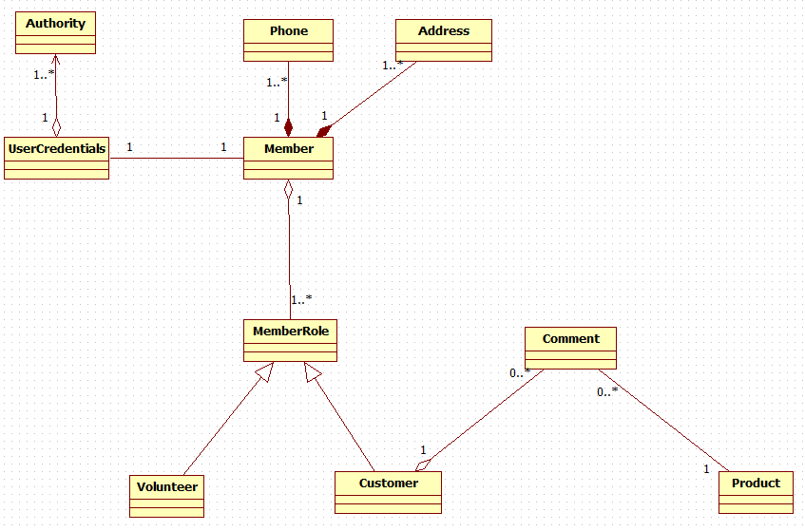
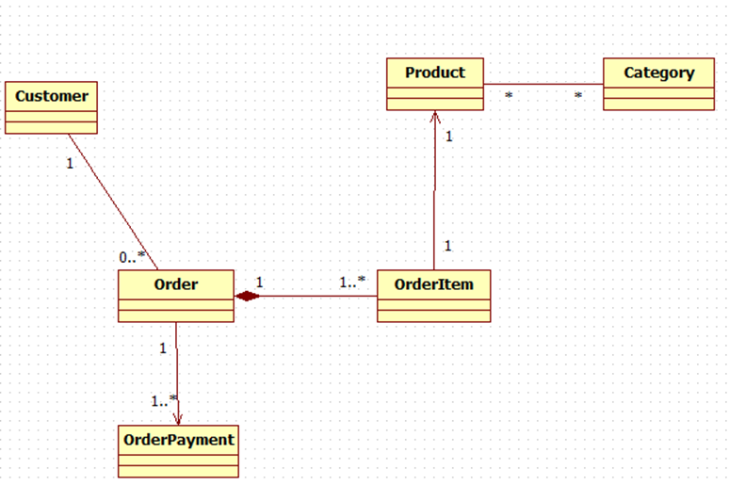
Target Application
Design Model
“possible”
Bounded Contexts

Slide 7
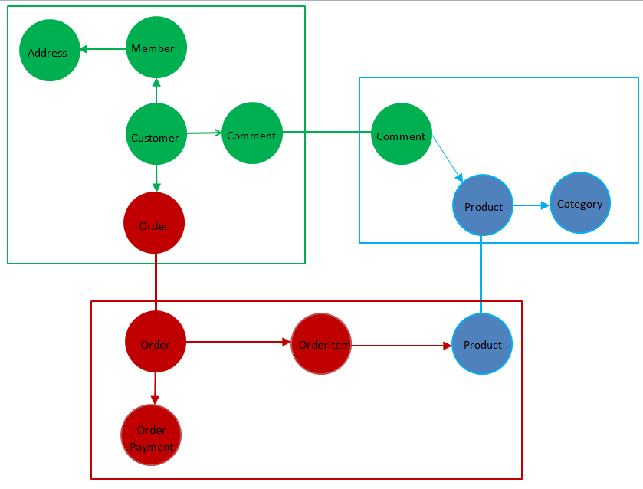
Bounded Context Model
Notes:
https://medium.com/@shijuvar/microservices-overview-misinterpretations-and-misuses-56a1979edafb
Aggregates .vs. bounded context

Slide 8




Component N-Tier
We’ll look at Bounded Context for Product in Lesson 13
Comment

Slide 9
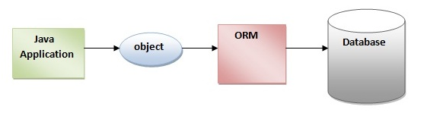
Basic Function of ORM
Acts as a “Gateway” between OO Domain & Relational Database
Maps Object to Relational Model & vice versa

Slide 10
Object-Relational Mapping [ORM]
The Domain Model in a Relational World
Enterprise Applications employ OO in design and implementation
&
Relational Databases for Persistence
There exists a MISMATCH
ORM tools essentially present a relational database from an object oriented viewpoint
The ORM is not for enhancing the Domain Model, it is simply a tool to “overcome” the O/R differences & to hide SQL.

Slide 11
ORM Impedance Mismatch
2 Different Technologies – 2 different ways to operate
EXAMPLE
OO traverse objects through relationships
Category category = product.getCategory();
RDB join the data rows of tables
SELECT c.* FROM product p,category c where p.category_id = c.id;
OTHERS:
Many-to-many relationships
Inheritance
Collections
Keys;Foreign Keys

Slide 12
Main Point
An Object Relational Mapping framework provides an Object-Oriented approach to data storage; simplifying the access to the database and effortlessly handling the persistence management for us.
Science of Consciousness: Transcendental Meditation is an effortless technique to bring us to the simple state of awareness

Slide 13
ORM USE CASE
For applications based on a rich domain model.
complex business rules
complex interactions between entities
Value is dealing with the full complexity of
object/relational persistence.
On the other hand:
An application with only a few entities and simple relationships could be adequately server by direct database table-oriented solutions

Slide 14
WARNING WARNING ORM IS HARD
“Let the ORM deal with the database.” - anonymous
Works for small applications and loads, but it soon falls apart once “things” get interesting.
ORM == 80% of the mapping problems
The other 20% requires “manual labor” at times by a Relational Database expert [ RE: DBA type]
Basic ORM benefit is automating the grunt work –relieves the developer from writing all that tedious boiler plate CRUD column to property mapping code.
BIG MISTAKE!!!

Slide 15
Basic ORM features
Mapping Classes To Tables
Out Of The Box CRUD Functionality
Hydrating Entities **
Executing Custom “OO” Queries
Cache management
Concurrency support
Transaction management
** “Automatically” Populate Table data to Object including Relationships
Notes:
multiple user DB updates simultaneously
Session Level Cache

Slide 16
Brief ORM History
NeXT Enterprise Object Framework 1994
RogueWave DBTools – 1994
TopLink for Smalltalk - 1995
TopLink for Java – 1997
ObjectExtender for Smalltalk 1998
Hibernate 2002
iBatis Database layer [ SQL Maps & DAO] 2002
Java Data Objects 2002
Java Persistence API 2006

Slide 17
Java Persistence API
JPA is a specification – not an implementation.
JPA 1.0 (2006). JPA 2.0 (2009).
Standardizes interface across industry platforms
Object/Relational Mapping
  Specifically Persistence for RDBMS
Major Implementations [since 2006]:
  Toplink - Oracle implementation [donated to Eclipse foundation for merge with Eclipselink 2008]
  Hibernate - Most deployed framework. Major contributor to JPA specification.
  OpenJPA - (openjpa.apache.org) which is an extension of Kodo implementation.

Slide 18
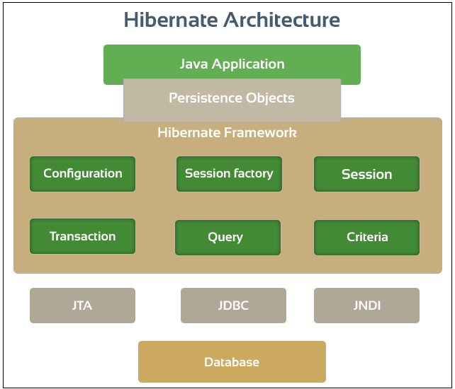
Oracle
MySQL
PostgreSQL
DB2/NT
FrontBase
Microsoft SQL Server
Sybase SQL Server
Informix Dynamic Server
HSQL Database Engine
Notes:
JTA
business operations that can modify multiple data stores at the same time and you need to ensure data consistency across all the stores, you will need to use JTA transactions.
JNDI – pooling, web lookup – needs tomcat
http://javainsimpleway.com/hibernate-with-tomcat-jndi-data-source-overview/
JNDI allows distributed applications to look up services in a resource-independent way.
Since its independent of any specific naming or directory service implementation, it enables applications to access different naming and directory services like DNS, LDAP, CORBA and RMI using a common API.
The JNDI style is typical when using an application server or a web container.
Java Naming and Directory Interface
http://www.oracle.com/technetwork/java/index-jsp-137536.html
configure the C3P0 connection pool in Hibernate WITHOUT JNDI

Slide 19
Range of ORM implementations
JDBC “ORM”
Hibernate XML
Hibernate Annotations
Hibernate Spring Transactions
Hibernate Spring – JPA
Hibernate Spring Data
Notes:
EVOLUTION THEREOF ???
Hibernate tools install for eclipse
Get url add to help/install new software ??
Help>Install new software>Uncheck “Contact all update sites during install to find required software”
Down load Mysql driver
SeT UP console config
Click on project in Hib Tools perspective
File->new-> hbm
Remove all but domain package
Next
finish

Slide 20
JDBC “ORM” - VehicleDAOImpl
public void insert(Vehicle vehicle) {
String sql= "INSERT INTO VEHICLE (VEHICLE_NO, COLOR, WHEEL, SEAT)"
+ "VALUES (?, ?, ?, ?)";
Connection conn = null;
try {
conn = dataSource.getConnection();
PreparedStatement ps = conn.prepareStatement(sql);
ps.setString(1, vehicle.getVehicleNo());
ps.setString(2, vehicle.getColor());
ps.setInt(3, vehicle.getWheel());
ps.setInt(4, vehicle.getSeat());
ps.executeUpdate();
ps.close();
} catch (SQLException e) {
throw new RuntimeException(e); SEE JDBCDao DEMO
} finally {
if (conn != null) {
try {
conn.close();
} catch (SQLException e) {}
}
}
}
Database “managed” transaction
JDBC Connection is in auto-commit mode by default

Slide 21
Hibernate GenericDAOImpl
@Autowired
protected SessionFactory sessionFactory; BACK
protected Session getSession() {return sessionFactory.getCurrentSession(); }
@Override
public void save( T entity ){
Transaction tx=null;
try {
tx = this.getSession().beginTransaction();
this.getSession().save(entity);
tx.commit();
}
catch (Exception e) {
if (tx!=null) tx.rollback();
throw e;
} SEE HibernateSolo DEMO
finally {
getSession().close();
}
Explicitly managed Session & Transaction
Notes:
Transaction is AOP “tangled”

Slide 22
Hibernate XML Domain Mapping File
<?xml version="1.0" encoding="UTF-8"?>
<!DOCTYPE hibernate-mapping PUBLIC
"-//Hibernate/Hibernate Mapping DTD 3.0//EN"
"http://www.hibernate.org/dtd/hibernate-mapping-3.0.dtd">
<hibernate-mapping package="edu.mum.domain">
<class name="Vehicle" table="VEHICLE">
<id name="id" column="ID">
<generator class="native"/>
</id>
<property name="color" column="COLOR" />
<property name="wheel" column="WHEEL" />
<property name="seat" column="SEAT" />
<property name="vehicleNo" column="VEHICLE_NO" />
</class>
</hibernate-mapping>

Slide 23
Annotation-based Domain Mapping
@Entity(name = "VEHICLE")
public class Vehicle {
@Id
@GeneratedValue(strategy=GenerationType.AUTO)
@Column(name="ID")
private long id;
@Column(name="VEHICLE_NO")
private String vehicleNo;
@Column(name="COLOR")
private String color; SEE HibernateAnnotations DEMO
@Column(name="WHEEL")
private int wheel;
@Column(name="SEAT")
private int seat;
Annotations INSTEAD of XML mapping files

Slide 24
Spring ORM Support
Comprehensive transaction support is one of the compelling reasons to use the Spring Framework.
Integration with Hibernate, Java Persistence API (JPA)…
Hibernate Support
First-class integration support through IoC/DI
Easier testing
Resource management
Integrated transaction management
Spring Framework Data Access

Slide 25
Hibernate Spring Managed Transactions
..On Service Layer
@Service
@Transactional → Starts Transaction
public class VehicleServiceImpl implements edu.mum.service.VehicleService {
public void save( Vehicle vehicle) {
vehicleDao.save(vehicle);
}
____________________________________________________________
public abstract class GenericDaoImpl<T> implements GenericDao<T> {
@Autowired
protected SessionFactory sessionFactory;
protected Session getSession() {
return sessionFactory.getCurrentSession();
} SEE HibernateTransactions DEMO
public void save( T entity ){
this.getSession().save(entity);
}
Reduction in code*:
manage transaction
open/close session
* Compared to Hibernate Solo

Slide 26
JPA Example
public abstract class GenericDaoImpl<T> implements GenericDao<T> {
@PersistenceContext
protected EntityManager entityManager;
protected Class<T> daoType;
public void setDaoType(Class<T> type) {
daoType = type;
}
SEE HibernateSpringJPA DEMO
@Override HibernateSpringJPAJConfig
public void save( T entity ){ HibernateSpringBoot
entityManager.persist( entity );
}
EntityManager “replaces” Session
Notes:
Basic mapping demo

Slide 27
JPQL - Data Object Queries
JPA Query Language
JPQL is different from SQL in that it operates on objects, attributes and relationships instead of tables and columns.
Queries are declared in the DAO implementation
@Repository
public class MemberDaoImpl extends GenericDaoImpl<Member> implements MemberDao {
public MemberDaoImpl() {
super.setDaoType(Member.class );
}
public Member findByMemberNumber(Integer memberNumber) {
Query query = entityManager.createQuery("select m from MEMBER m
where m.memberNumber =:number");
return (Member) query.setParameter("number", memberNumber).getSingleResult();
}
Notes:
MEMBER is entity name…memberNumber is entity property

Slide 28
Spring Data
Spring Data
  High level Spring project whose purpose is to unify and ease the access to different kinds of persistence stores, both relational database systems and NoSQL data stores.
Hibernate ORM
  (Hibernate for short) is an object-relational mapping Java library;
  a framework for mapping an object-oriented domain model to a
  traditional relational database. Distributed under the GNU Lesser General Public License
Notes:
JBOSS- Hibernate
Pivotal – Spring/Tomcat

Slide 29
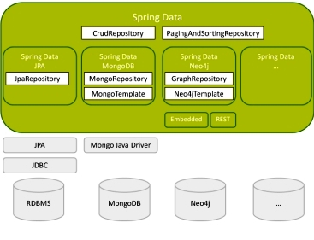
Spring Data Project
  High level Spring project whose purpose is to unify and ease the access to different kinds of persistence stores, both relational database systems and NoSQL data stores.
Notes:
https://en.wikipedia.org/wiki/NoSQL#Types_and_examples_of_NoSQL_databases

Slide 30
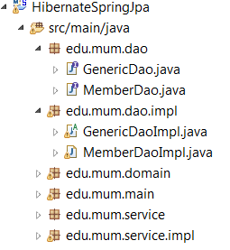
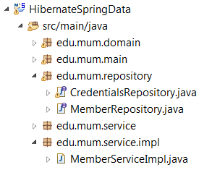
Spring Data
AUTO-GENERATES the DAO
No Need for GenericDAO,
etc.
@Repository
public class MemberDaoImpl extends GenericDaoImpl<Member> implements MemberDao {
public MemberDaoImpl() {
super.setDaoType(Member.class );
}
public Member findByMemberNumber(Integer memberNumber) {
Query query = entityManager.createQuery("select m from MEMBER m
where m.memberNumber =:number");
return (Member) query.setParameter("number", memberNumber).getSingleResult();
}
BECOMES
@Repository
public interface MemberRepository extends CrudRepository<Member, Long>
{
public Member findByMemberNumber(Integer memberNumber);
} See HibernateSpringData

Slide 31
Main Point
JPA is a specification not an implementation. It provides a consistent, reliable mechanism for data storage and retrieval that alleviates the application developer from the details involved in the persistence layer.
The mechanism of transcending allows the individual to tap into the Home of all the Laws of Nature alleviating the stress of mundane day to day issues.

